Slide 1
The RC4 Algorithm
Network Security

Slide 2
The RC4 Algorithm
Objectives of the Topic
After completing this topic, a student will be able to
explain working of RC4 algorithm.

Slide 3
The RC4 Algorithm
Figures and material in this topic have been
adapted from “Network Security Essentials: Applications and Standards”, 2014, by William Stallings.

Slide 4
The RC4 Algorithm
RC4 is a stream cipher designed in 1987 by Ron Rivest for RSA Security.
It is a variable key-size stream cipher with byte-oriented operations.

Slide 5
The RC4 Algorithm
RC4 is used in the Secure Sockets Layer/Transport Layer Security (SSL/TLS) standards that have been defined for communication between Web browsers and servers.

Slide 6
The RC4 Algorithm
Also used in the Wired Equivalent Privacy (WEP) protocol and the newer WiFi Protected Access (WPA) protocol that are part of the IEEE 802.11 wireless LAN standard.

Slide 7
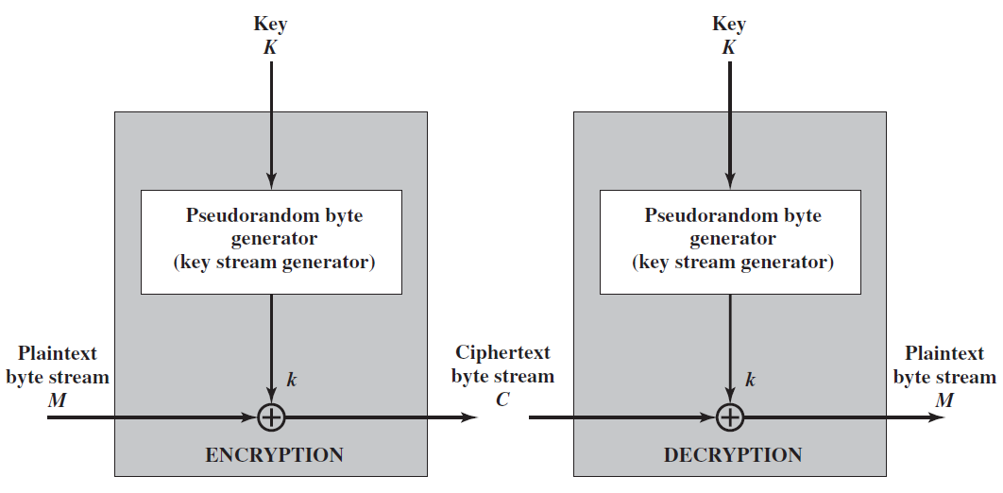
The RC4 Algorithm
A generic
view

Slide 8
The RC4 Algorithm
The RC4 algorithm is remarkably simple.
A variable-length key of from 1 to 256 bytes (8 to 2048 bits) is used to initialize a 256-byte state vector S, with elements S[0], S[1], . . . , S[255].

Slide 9
The RC4 Algorithm
For encryption and decryption, a byte k is generated from S by selecting one of the 255 entries in a systematic fashion.
As each value of k is generated, the entries in S are once again permuted.

Slide 10
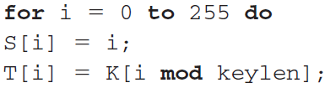
The RC4 Algorithm
Initialization of S:
entries of S are set equal to the values from 0 through 255 in ascending order
Where T is a temporary vector.

Slide 11
The RC4 Algorithm
If the length of the key K is 256 bytes, then K is transferred to T.
Otherwise, first keylen elements of T are copied from K, and then K is repeated as many times as necessary to fill out T.

Slide 12
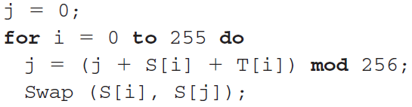
The RC4 Algorithm
Next we use T to produce the initial permutation of S.

Slide 13
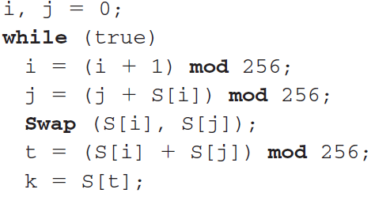
The RC4 Algorithm
Stream Generation: Once the S vector is initialized, the input key is no longer used.

Slide 14
The RC4 Algorithm
To encrypt, XOR the value k with the next byte of plaintext.
To decrypt, XOR the value k with the next byte of ciphertext.

Slide 15
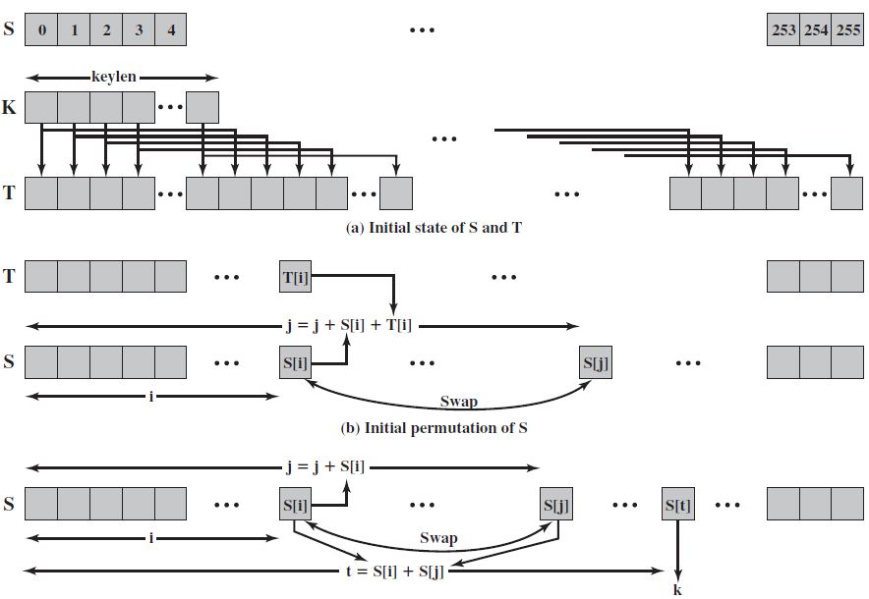
The RC4 Algorithm
With the current technology, a key length of at least 128 bits is desirable.
End

Slide 16
The RC4 Algorithm
Strength of RC4:
A number of papers have been published analyzing methods of attacking RC4.
None of these approaches is practical against RC4 with a reasonable key length, such as 128 bits.
End

